Slide 1
ONLINE TEST
Nisha Devikar
Payal Kamde
Ajay Redhu
Ajay Rana
Shefali Hulde

Slide 2
Dashboard
Home Dashboard-
Admin and User
No. of users, no. of attempts, sections,subjects, exams, performance graph.
Admin Dashboard-
Login, signup page
Subjects wise Test Upload manually, performance record, managing users(student’s list).
User Dashboard-
User will attempt the test, score-card, rank-wise batch, section-wise timer.
In case of network interruptions test will resume(from the current page).

Slide 3
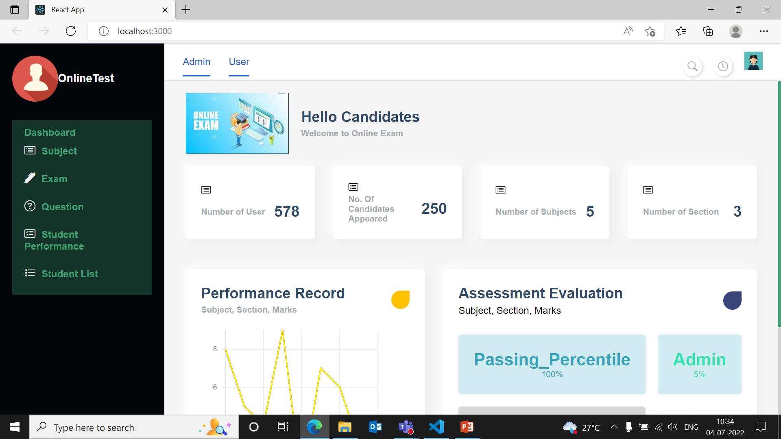
Home Dashboard (02/07/22-03/07/22)

Slide 4
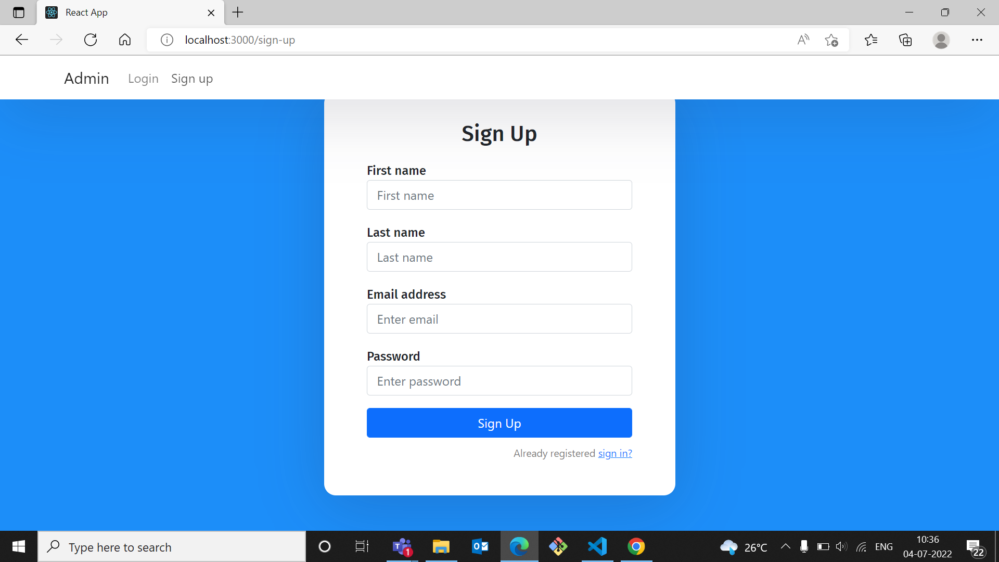
Login and Sign up page (02/07/22-03/07/22)

Slide 5
